Slide 1
INTEGRALS
CONTENT
What Integration is.
Geometrical Interpretation
Properties
Basic Formula
Methods of Integration
Integration By Parts
Practice Questions .
Definite Integrals
Areas of Curves

Slide 2
What Integral is ?
Integration is the inverse process of differentiation. In the differential calculus, we are given a function and we have to find the derivative or differential of this function, but in the integral calculus, we are to find a function whose differential is given. Thus, integration is a process which is the inverse of differentiation.
Then, ∫f(x) dx = F(x) + C, these integrals are called indefinite integrals or general integrals. C is an arbitrary constant by varying which one gets different anti-derivatives of the given function.
Note: Derivative of a function is unique but a function can have infinite anti-derivatives or integrals.

Slide 3
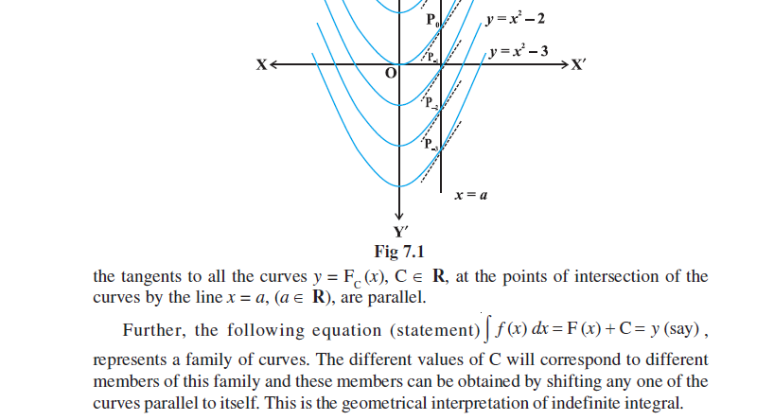
Geometrical Interpretation

Slide 4
Properties of Indefinite Integral
(i) ∫[f(x) + g(x)] dx = ∫f(x) dx + ∫g(x) dx
(ii) For any real number k, ∫k f(x) dx = k∫f(x)dx.
(iii) In general, if f₁, f₂,………, f_{n} are functions and k₁, k₂,…, k_{n} are real numbers, then
∫[k₁f₁(x) + k₂ f₂(x)+…+ k_{n}f_{n}(x)] dx = k₁ ∫f₁(x) dx + k₂ ∫ f₂(x) dx+…+ k_{n} ∫f_{n}(x) dx

Slide 5
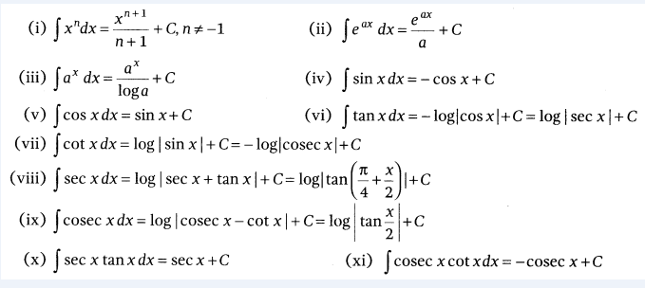
Basic Formulae

Slide 6
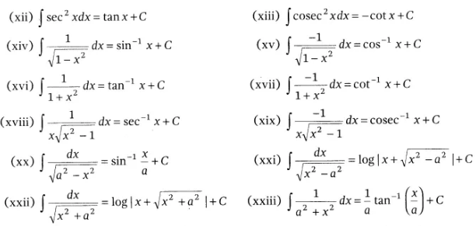
Basic Formulae

Slide 7
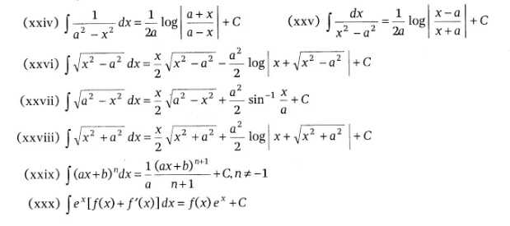

Slide 8
Methods of Integration
Integration by Substitutions
Substitution method is used, when a suitable substitution of variable leads to simplification of integral.
If I = ∫f(x)dx, then by putting x = g(z), we get
I = ∫ f[g(z)] g'(z) dz
Note: Try to substitute the variable whose derivative is present in the original integral and final integral must be written in terms of the original variable of integration.

Slide 9
Methods of Integration
Integration by Parts
For a given functions f(x) and q(x), we have
∫[f(x) q(x)] dx = f(x)∫g(x)dx – ∫{f'(x) ∫g(x)dx} dx
Here, we can choose the first function according to its position in ILATE, where
I = Inverse trigonometric function
L = Logarithmic function
A = Algebraic function
T = Trigonometric function
E = Exponential function
[The function which comes first in ILATE should taken as first junction and other as second function]
Note
(i) Keep in mind, ILATE is not a rule as all questions of integration by parts cannot be done by above method.
(ii) It is worth mentioning that integration by parts is not applicable to product of functions in all cases. For instance, the method does not work for ∫√x sinx dx. The reason is that there does not exist any function whose derivative is √x sinx.
(iii) Observe that while finding the integral of the second function, we did not add any constant of integration.

Slide 10
Methods of Integration
Integration by Partial Fractions
A rational function is ratio of two polynomials of the form p(x)/q(x) = t(x) + h(x)/q(x), where p(x) and q(x) are polynomials in x and q(x) ≠ 0. If degree of p(x) > degree of q(x), then we may divide p(x) by q(x) so that , where t(x) is a polynomial in x which can be integrated easily and degree of h(x) is less than the degree of q(x) .h(x)/q(x) can be integrated by expressing h(x)/q(x) as the sum of partial fractions of the following type(next slides)

Slide 11
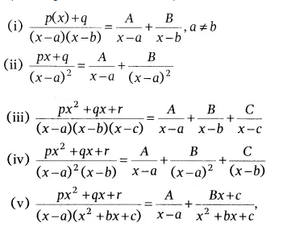
Partial Fractions
Methods

Slide 12
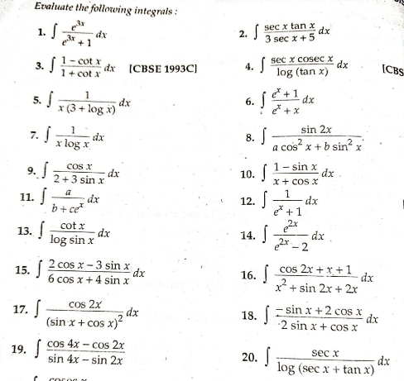
Exercise-1

Slide 13
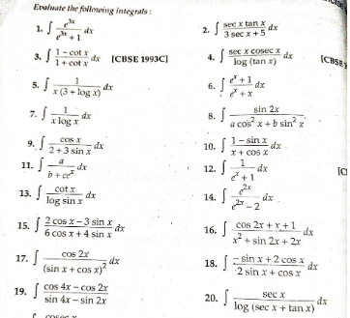
Exercise

Slide 14
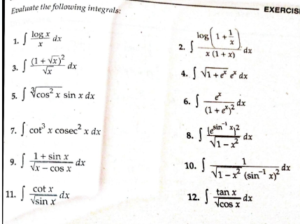
Exercise

Slide 15
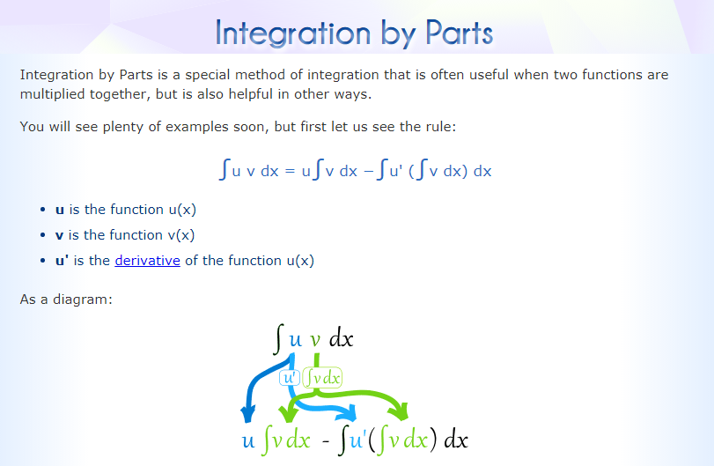
Integration By Parts

Slide 16
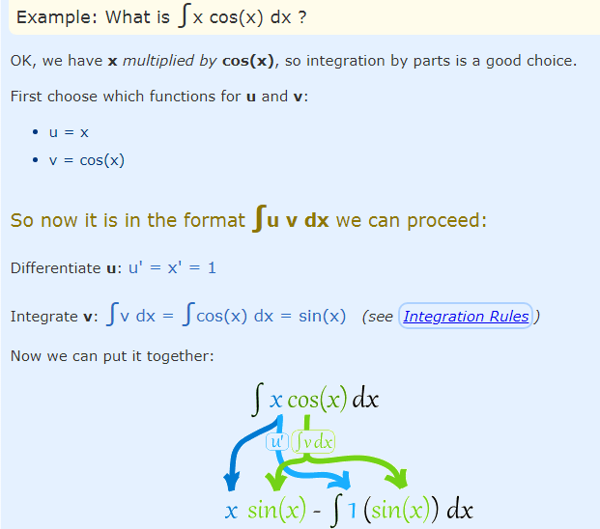
Integration By Parts

Slide 17
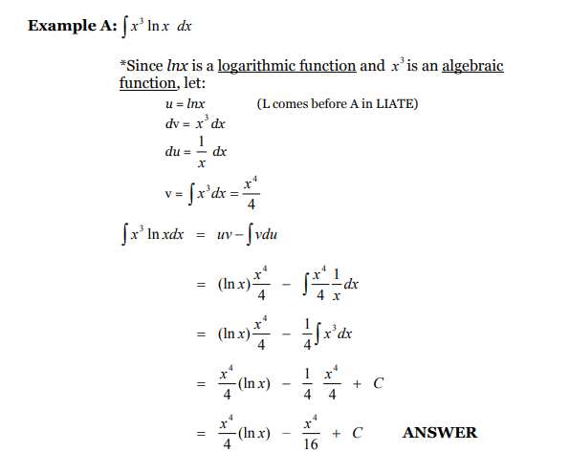
For u…

Slide 18
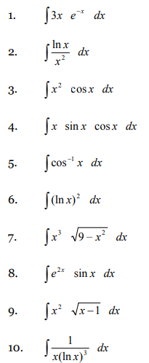
Examples

Slide 19
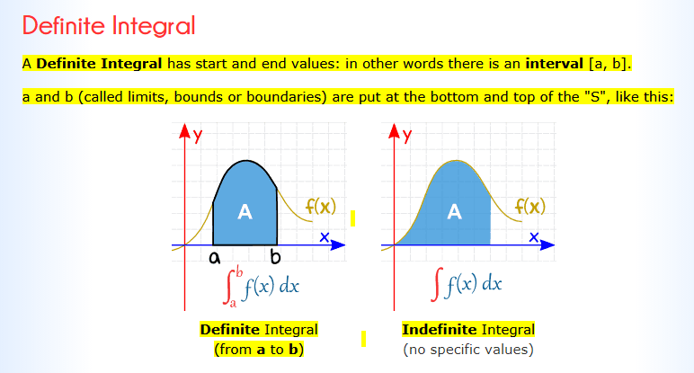
Definite Integrals

Slide 20
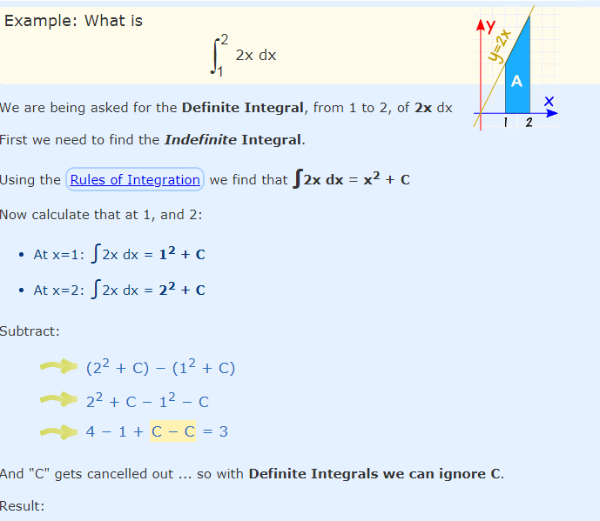
Definite Integrals

Slide 21
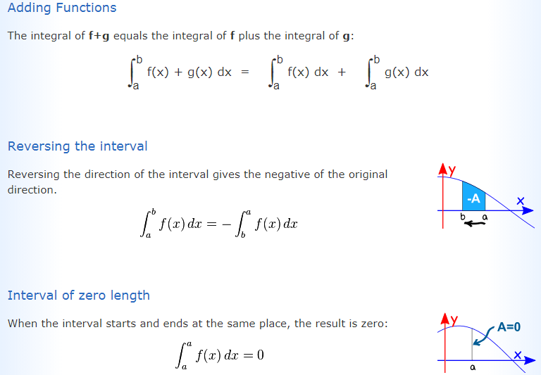
Definite Integrals

Slide 22
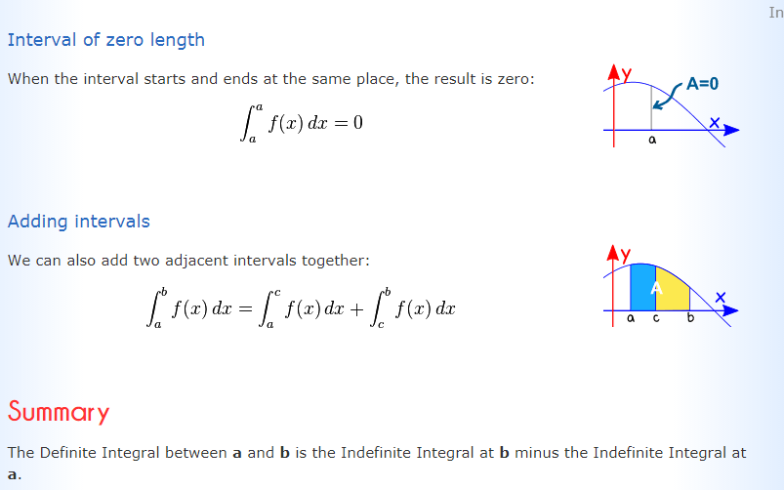
Definite Integrals

Slide 23
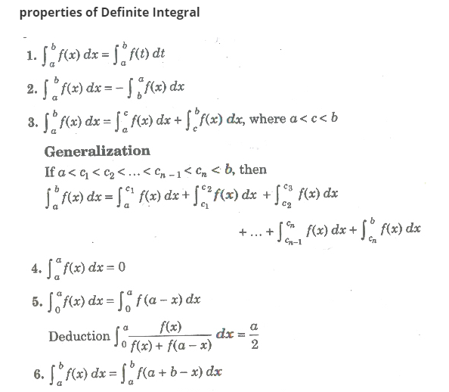
Properties of Definite Integrals

Slide 24
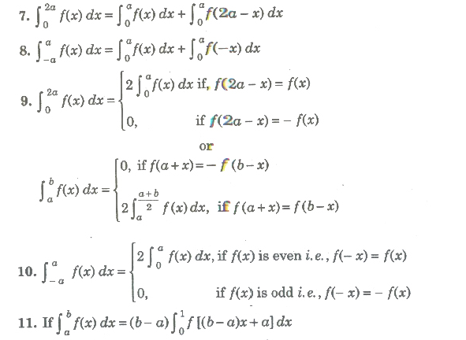
Properties of Definite Integrals

Slide 25
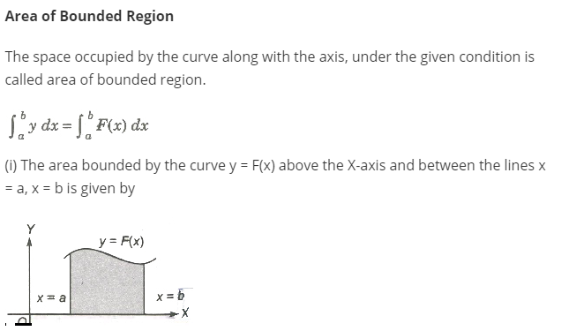
Area of Curves

Slide 26
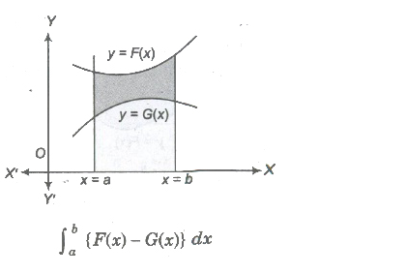
Area Between Curves
Area bounded by two curves y = F (x) and y = G (x) between x = a and x = b is given by..

Slide 27

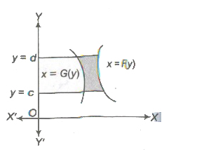
Area Between Curves
Area bounded by two curves x = f(y) and x = g(y) between y=c and y=d is given by

Slide 28
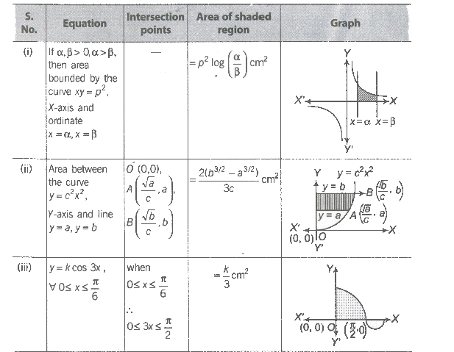
Area Between Curves

